Slide 1

T99X171.00 Control Run
Test Yield Rate
Prepare by: PE- Nam
Date: Jan 28th 2021

Slide 2
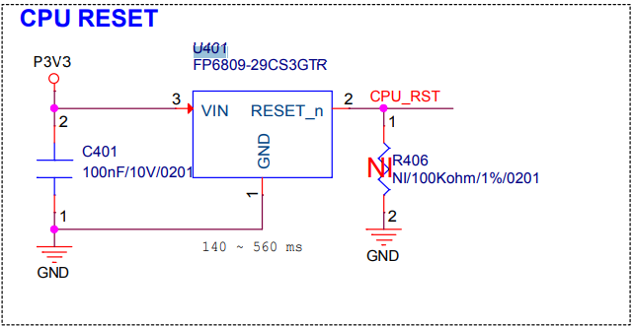
Control Run Content
1. Issue:
- T99X171.00 model need to do control run 100pcs verify 2nd source for location U401(current source: 039.00272.005, 2nd source: 038.00002.G05 )
2. Detail:
No.# | Main source | 2nd source | Location | Describe Material | Vendor 2nd source
1 | 039.00272.005 | 038.00002.G05 | U401 | TPV809S-3TR reset IC | 3PEAK
3. Purpose:
- Due to main source shortage seriously, need build control run to check function of 2nd source material source P/N: 038.00002.G05 location U401

Slide 3
Control Run Procedure
Process as below:
Kitting => SMT ( Use new U401 (P/N: 038.00002.G05) => AOI => X-ray(100%) => PTH => IPQC VI 100% => LINK => UK => FT1 => FT2 => Burnin 8 hours (5%) => FT3 (5%) => RC => Burnin 6mins => RC1 ==> Power on/off in 30 times ( power on: 3 mins / power off: 30s) => OBA (100%) => RC2 => ORT => VI => Packing => FG.
Step | Items | Contents | Remark
1 | Kitting | Provide material to do control run
2 | SMT | Surface mounting technology | Check first PCB to make sure control run material
3 | AOI | AOI 100% PCBA before and after Re-flow | Make sure none process issue
4 | X-ray | X-ray 100% | Take X-ray 100% to check solder short
5 | PTH | Paste through hole | Check VI material polarity
6 | FATP | Focus on new material location U401 with P/N: 038.00002.G05 | Check if NG products are related to 2nd source material, confirm symptom & FA report.
7 | Power on/off | 100% power on /off 30times (on : 3 mins/ off : 30 seconds)
8 | OBA ( 100%) | Check function of products
Remark: RD and customer request that we don't need to use RCU (311.00106.005LT) and ADP (381.00607.005LT) at packing station for this MO.

Slide 4

Test Yield Rate
OTT |  |  |  | Model Name: T99X171.00
 |  |  |  | Quantity: | 100pcs
 |  |  |  | Version | 0bL4C
 |  |  |  | Production image | k000b-523r06_SD_fac-20211001
 |  |  |  | Customer image | 15.531.10
 |  |  |  | MO | 2643000985
 |  |  |  | Date | 2022/01/26
1.Product Yield & FA Report
Customer | Product Model | Test Station |  |  | Yield Rate | Statistical | Yield Rate
OTT | T99X171.00 | UK |  |  | 100.00% | Total | 100
 |  |  |  |  |  | Pass | 100
 |  |  |  |  |  | Fail | 0
 |  |  |  |  |  | Yield Rate(%) | 100%
 |  | FT |  |  | 100.00% | Total | 100
 |  |  |  |  |  | Pass | 100
 |  |  |  |  |  | Fail | 0
 |  |  |  |  |  | Yield Rate(%) | 100%
 |  | FT1 |  |  | 100.00% | Total | 100
 |  |  |  |  |  | Pass | 100
 |  |  |  |  |  | Fail | 0
 |  |  |  |  |  | Yield Rate(%) | 100%
 |  | RC |  |  | 100.00% | Total | 100
 |  |  |  |  |  | Pass | 100
 |  |  |  |  |  | Fail | 0
 |  |  |  |  |  | Yield Rate(%) | 100%
 |  | RC1 |  |  | 100.00% | Total | 100
 |  |  |  |  |  | Pass | 100
 |  |  |  |  |  | Fail | 0
 |  |  |  |  |  | Yield Rate(%) | 100%
 |  | RC2 |  |  | 100.00% | Total | 100
 |  |  |  |  |  | Pass | 100
 |  |  |  |  |  | Fail | 0
 |  |  |  |  |  | Yield Rate(%) | 100%
 |  | Final Yield Rate(%) |  |  | 100.00%

Slide 5
Conclusion
The final test yield rate is : 100%.
Base on power on/off & test OBA result 100pcs : Don’t find out any product function fail related to 2nd source for location U401, P/N: 038.00002.G05
Control run result is Pass. Factory can apply for MP

